Slide 1
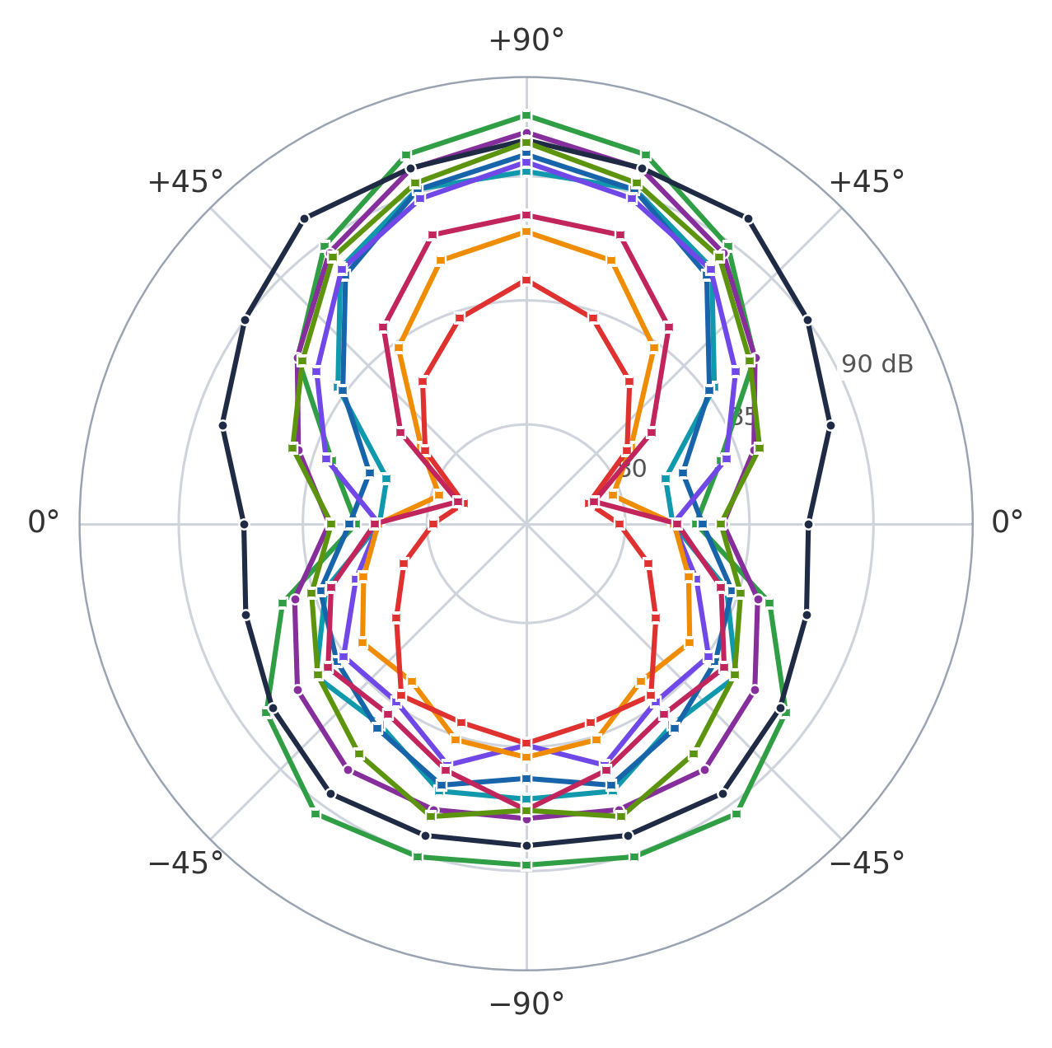
THE MEMBRANES
Membranes at 2000 µs
Mean level. Round markers: 8 Oct. Square: 9 Oct.
Thinsulate, 4 layers
9 Oct
82.8 dB
Thinsulate, 2 layers
9 Oct
84.0 dB
Thinsulate, 8 layers
9 Oct
85.0 dB
Felt + rubber
9 Oct
86.0 dB
Felt
9 Oct
86.3 dB
Felt, double layer
9 Oct
86.4 dB
Duct + PU foam, double
9 Oct
87.5 dB
PU foam
8 Oct
87.9 dB
Cork
9 Oct
88.5 dB
Duct, membrane only
8 Oct
89.5 dB
up to 10.2 dB
best (Thinsulate, 4 layers) against worst (Duct, membrane only), at +18°; 6.7 dB on average
8 and 9 Oct 2026, 5-inch 3-blade propeller, 500 Hz–24 kHz, 2000 µs, mean of 3 repeats, corrected files. Axis 76–94 dB. Not comparable with slide 8.
1
Notes:
Bases in the data repo (f30__5in3b__membrane-...): 8 Oct 2026: membrane-duct-small, membrane-open-pore-pu-foam. 9 Oct 2026: membrane-duct-open-pore-pu-foam-double-layer, membrane-felt, membrane-felt-double-layer, membrane-cork, membrane-felt-rubber, membrane-thinsulate-8-layers, -4-layers, -2-layers. Each base was captured with 3 repeats of the ramp; the plot uses the PWM 2000 step and the mean over the 3 repeats of the total level 500 Hz to 24 kHz per microphone, in dB SPL, read with the corrected microphone files. The repeat-to-repeat scatter of the mean level is 0.02-0.11 dB. There is no bare reference measured with this set-up (the base names carry a different motor field, f30, from the 2 and 7 Oct materials), so levels here are not comparable with slide 8 and no louder-than-bare figure is given; the callout is the difference between the quietest (best: Thinsulate, 4 layers) and the loudest (worst: duct, membrane only) set-up: 10.2 dB at its largest, at +18°, and 6.7 dB on average over the eleven microphones. Per angle the difference runs from 4.1 dB at -90 degrees to 10.2 dB at +18 degrees; the largest spread across all ten set-ups at a single angle is the same 10.2 dB. Two of the bases are ducts. The polar is mirrored to 360 degrees.

